Slide 1



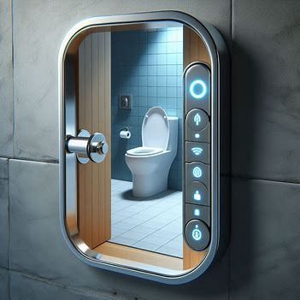

LOOGUARD
Smart bathroom Lock: An Innovative Solution

Slide 2

Content
01
Overview
02
Problem statement
03
Solution and path taken
04
Marketing plan
05
Effect on society
06
Future Applications

Slide 3





FlushLock System
Touchscreen Feedback
Overview
Enhanced User Experience
The Smart Bathroom Management System aims to revolutionize the management and user experience of public restroom facilities through the integration of innovative technologies.
Improves the overall hygiene
This system combines the FlushLock, a smart door locking mechanism, with a touchscreen feedback and maintenance reporting system to ensure privacy, security, cleanliness, and efficient maintenance of public bathrooms.

Slide 4


Problem Statement
In many public and shared-use bathrooms, ensuring hygienic practices can be challenging.This is mainly due to individuals neglecting or forgetting to flush the toilet.
Additionally, water wastage due to individuals leaving without flushing is a common concern.
Another subsequent issue due to the neglegence is the air quality in and around the washrooms that my develop into a health hazard.
The aim of this project is to design and implement a solution that addresses the above issues effectively. The solution and the methods are explained in the upcoming slides

Slide 5






Solutions
Since this project tackles the challenges of hygiene, water waste, and air quality in public and shared restrooms. The solution that we have come up with lies in a sensor-controlled exit system.
Sensor Integration: A sensor will be installed within the toilet flush mechanism. This sensor could utilize weight or pressure detection to confirm toilet usage.
Smart Lock Integration: Existing restroom door locks will be replaced with electronic locks programmed to receive signals from the toilet sensor. This sensor is activated only when the flush is used.
Functionality: Upon completion of a flush cycle, the sensor transmits a signal to the electronic lock, unlocking the restroom door for user exit.
This system promotes hygiene by ensuring proper waste disposal, reduces water waste by discouraging unfinished uses, and improves air quality by minimizing neglected restroom conditions. The next slides will delve deeper into the implementation methods for this innovative solution.

Slide 6
method of
SOLUTION
If, there is no water, or if the toilet is clogged or any other issue, just pressing the flush is sufficient in unlocking the door.
As a person enters the bathroom , he locks it manually
1
4
In future, it is planned to install a maintenance display outside the bathroom, which can be used to report any issues.
Once the person has used the toilet, he is required to press the flush.
2
5
It is also planned to install an automatic fragrance emitter, which emits when the flush is pressed
A button has been placed behind the flush, which on pressing, unlocks the door.
3
6

Slide 7

Effect on
Society
Improved hygiene: By linking door unlocking to flushing, users are more likely to properly dispose of waste, potentially reducing the spread of germs, especially in schools, offices,
01
Reduced vandalism: With doors remaining locked until the toilet is flushed, there may be a decrease in vandalism or misuse within restrooms.
02
03
Increased efficiency: Knowing a restroom is occupied based on sensor data could potentially help with cleaning schedules, allowing staff to prioritize restrooms that are actually in use.
Improved air quality: By ensuring proper waste disposal, this system could contribute to better air quality within restrooms, especially important in high-traffic areas..
04

Slide 8


Digital Marketing
Pricing and Product Enhancement
Marketing Plan
Identify Target Demographic
Marketing this product would be an interesting task as people would always as the question as to why it is needed as it is just a “fancy lock”. But, we need to show them that it is much more than that. Here, identifying the target demographic plays a very important role. Based on the target demographic the price and features of the product can be enhanced.
Digital Marketing is the most effective and fastest way to reach our target customers/consumers.
Segmentation of the Market

Slide 9
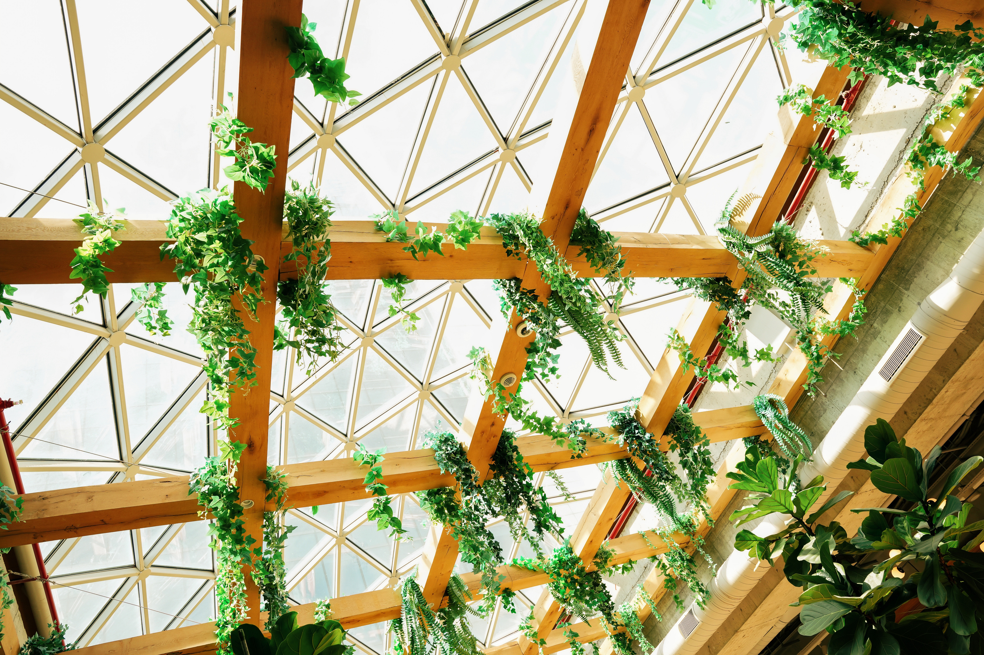
FUTURE SCOPE
Complaint Logging
Maintenance Reporting
Data Analytics
Users can use the touchscreen display to log complaints or issues they encounter in the bathroom, such as a lack of toilet paper, soap, or paper towels, or cleanliness concerns.
The touchscreen display will have options for users to report maintenance issues directly to the facility management team. This could include issues like water running out, toilets clogged, or any other plumbing-related problems.
The system will collect data on reported complaints and maintenance issues over time, enabling facility managers to identify recurring problems, allocate resources more efficiently, and improve overall bathroom maintenance strategies.

Slide 10


THANK YOU

